Slide 1


Beta Meeting
3/19/25

Slide 2
agenda
INTRODUCTION
INCUCTION CEREMONY
SERVICE OPPORTUNITY-COMING SOON
SERVICE HOUR FORMS DUE
Questions/Next meeting

Slide 3

Welcome! Glad to see you all.
Fill out the form on Remind to mark your attendance.

Slide 4

Induction Ceremony
March 25- Rehearsal 8:15 AM- Café
March 26- Induction Ceremony 5:30-7:15

Slide 5
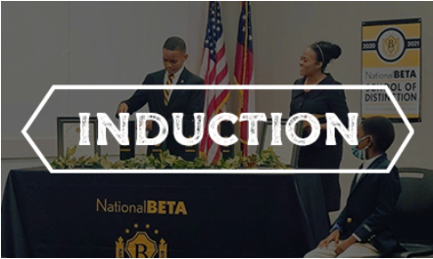
WE NEED YOUR HELP!
All board members are required to attend.
We need at least 6-10 more volunteers to help with candle
lighting portion of ceremony, and t-shirt distribution.
You will earn 5 service hours
Dress nicely, no jeans, or shorts.
March 25- Rehearsal 8:15 AM- Cafeteria
March 26- Induction Ceremony 5:30-7:15

Slide 6
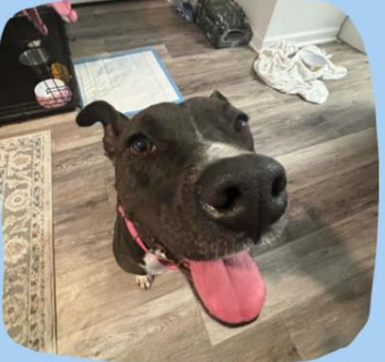
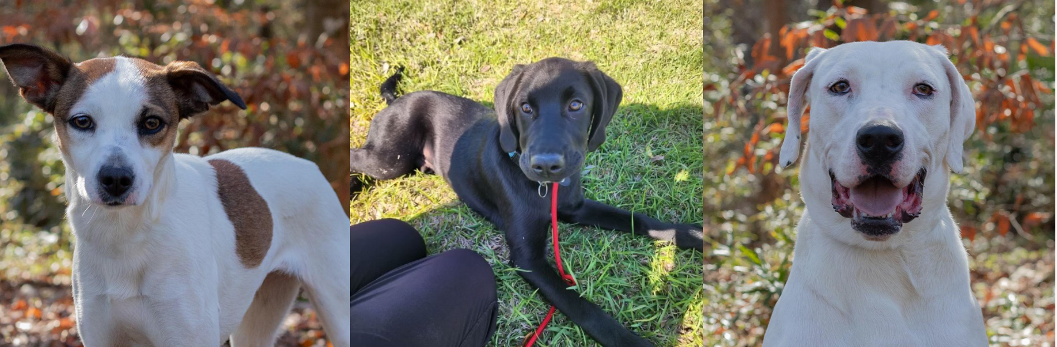
Next Up
Service opportunity
Collection dates: APRIL 7- 17

Slide 7

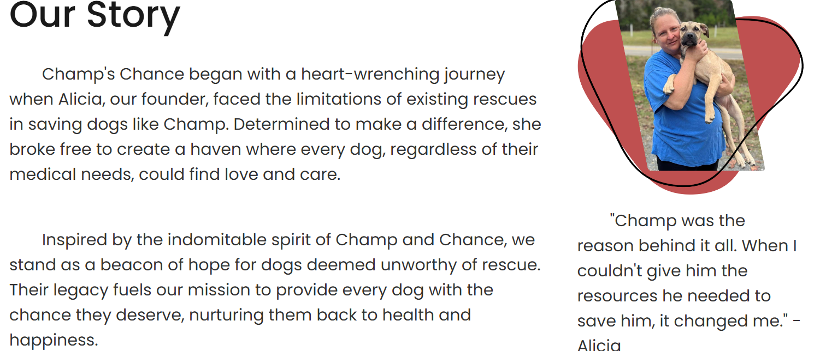
April-Kindness to Animal Month

Slide 8
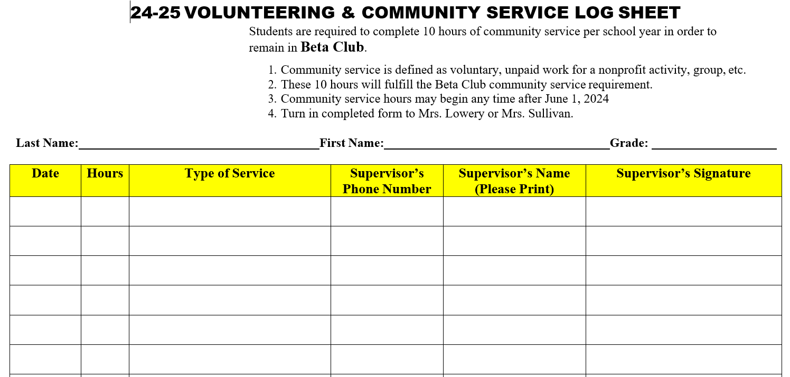
VOLUNTEER/SERVICE HOUR FORMS DUE SOON
Print a form from
Webpage
Remind
2. Fill out the form entirely.
3. Get all signatures
4. Turn in to Mrs. Sullivan
5. DUE by: APRIL 2!!!

Slide 9

NEXT MEETING FOR 6-8: BETA MEMBERS- APRIL 2, 2025
FIELD TRIP: HANGAR 38
APRIL 25TH 9:30-1:00

